Slide 1

IT Helpdesk Support Aplication with Android Studio

Slide 2








Organizational Structure Group 1
Bagus Indiarto
Backend
Rusheila Donna Ardinsya
M. Jadid AbiPraya
Project Manager
Backend
Frontend
DB
Oktasanti Puteri
Steady

Slide 3

IDENTIFICATION OF THE PROBLEMS
Problem
For handling problems, both the application used and the device used in terms of reporting, they still have to go through the helpdesk process.
Potential Solution
We propose the idea of an IT Helpdesk Support Application that functions for reporting any IT problems to the related application team.

Slide 4

What is IT Helpdesk Support Aplication?
Helpdesk Support Application is a popular customer service tool that is designed to convert support issues and requests into tickets.

Slide 5

Benefit IT Helpdesk Support Aplication
Efficient & Effective
Assign Ticket to the right member of team
Resolve tickets faster with internal collaboration

Slide 6


Who uses IT Helpdesk Support Application?
Non – IT Employee
IT Employee
Non- IT Employee as an employee who can create tickets based on their issues.
Developers team that’s helps handle and resolved issues in many application.

Slide 7
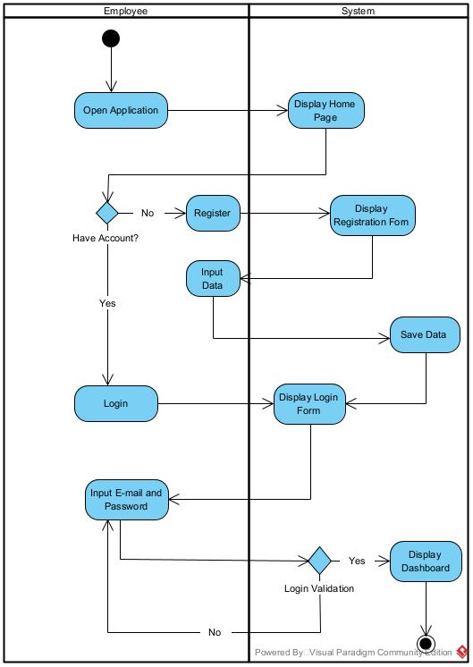
Activity Diagram
Diagram login employee & developer

Slide 8
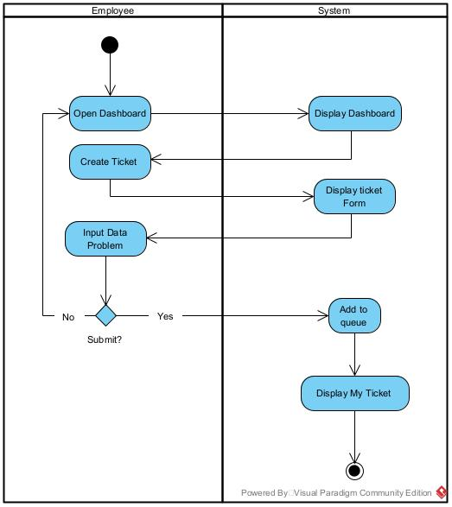
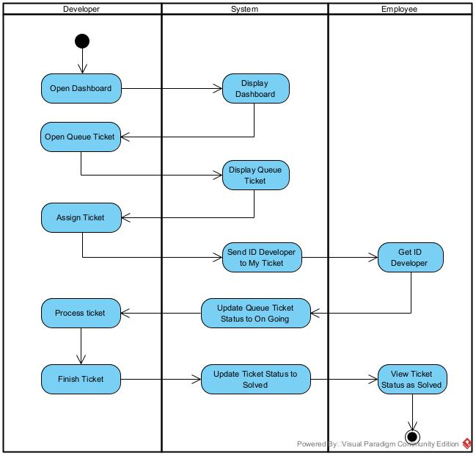
Activity Diagram
Diagram Create ticket & process

Slide 9
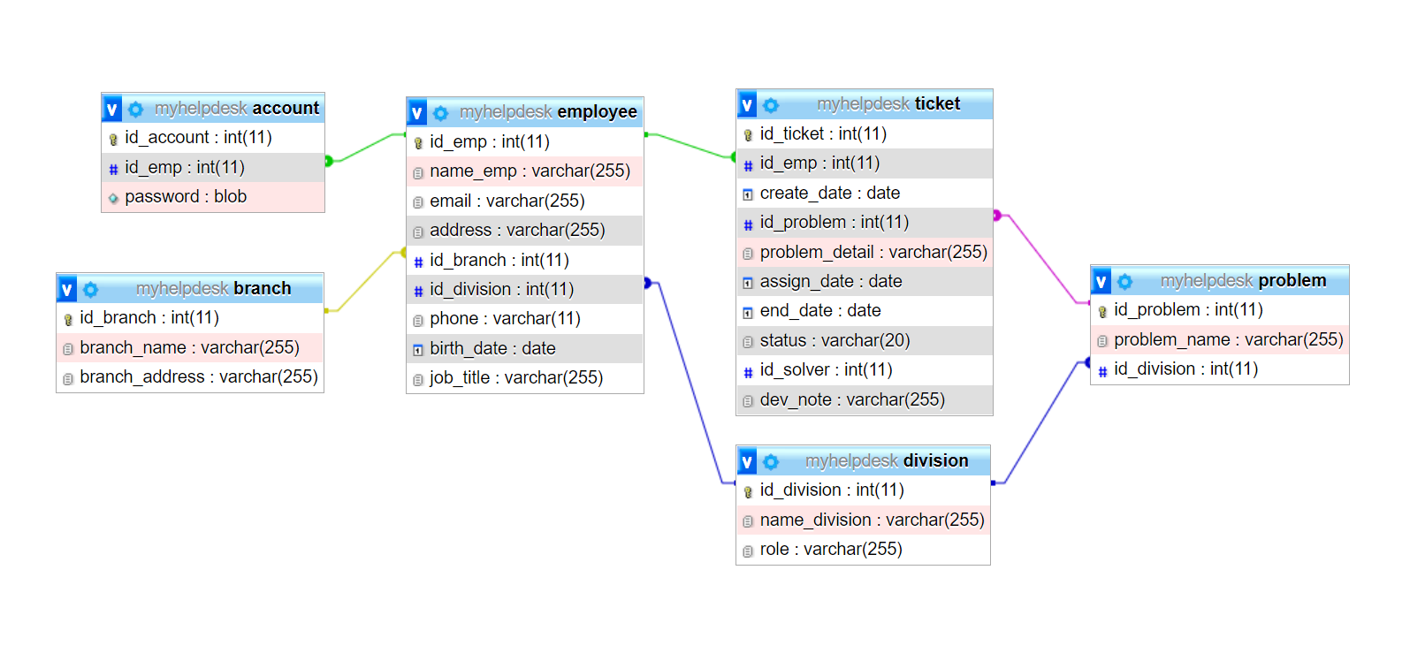
Entity Relationships Diagram

Slide 10







FLOW PROCESS IT Helpdesk Support Application
Ticket on the queue
Developer starts working on the ticket
New Ticket
Queue Ticket
Ongoing Ticket
Ticket Assign to developer
Dev write note to solved ticket
Permanently closed
Assigned
Solved
Process by Developer
Ticket submitted by employee

Slide 11
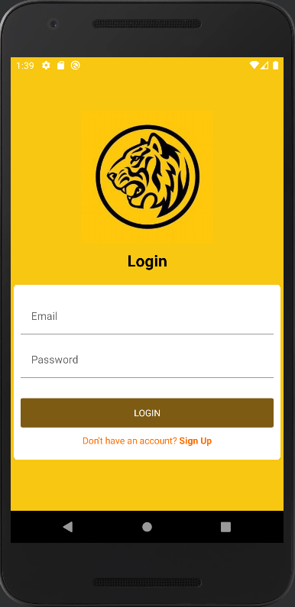
LOGIN FORM

Slide 12
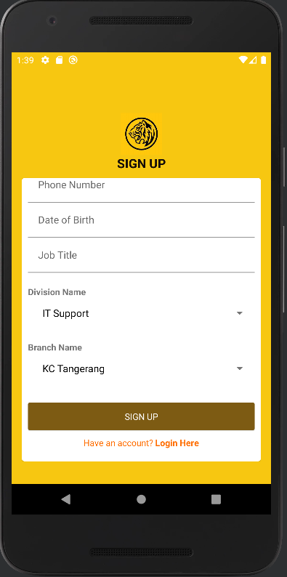
REGISTRATION FORM

Slide 13
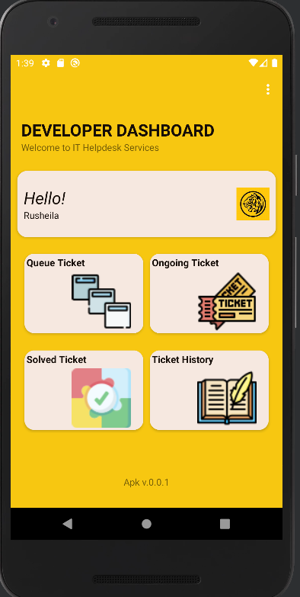
DASHBOARD DEVELOPER

Slide 14
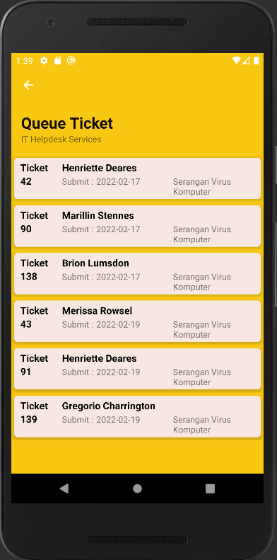
MENU QUEUE TICKET DEVELOPER

Slide 15
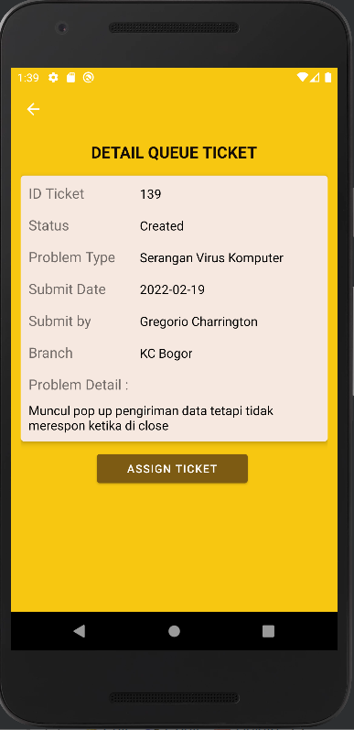
DETAIL ASSIGN PROBLEM, DEVELOPER

Slide 16
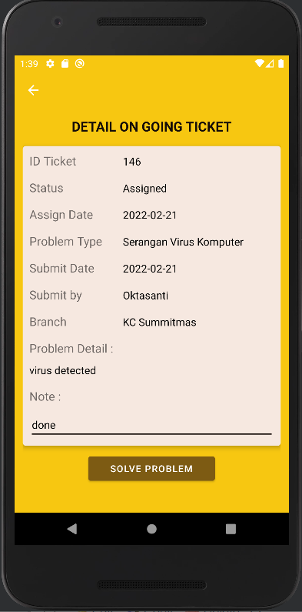
MENU ON GOING TICKET, DEVELOPER

Slide 17
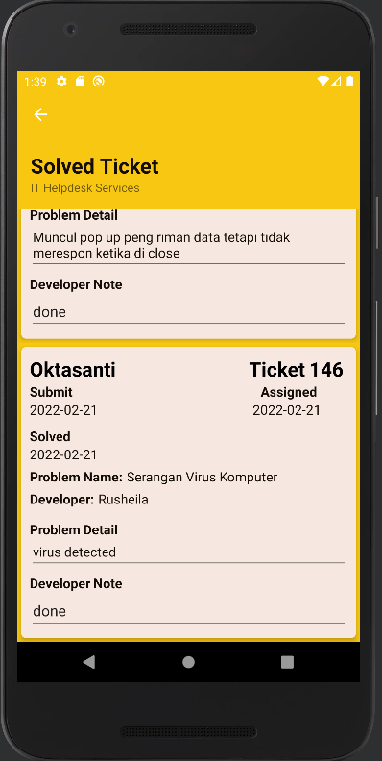
MENU SOLVED TICKET, DEVELOPER

Slide 18
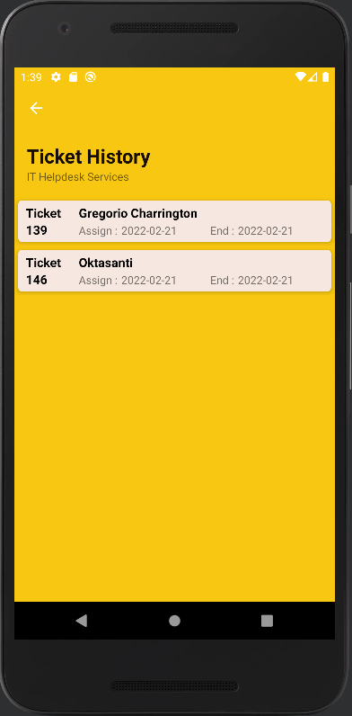
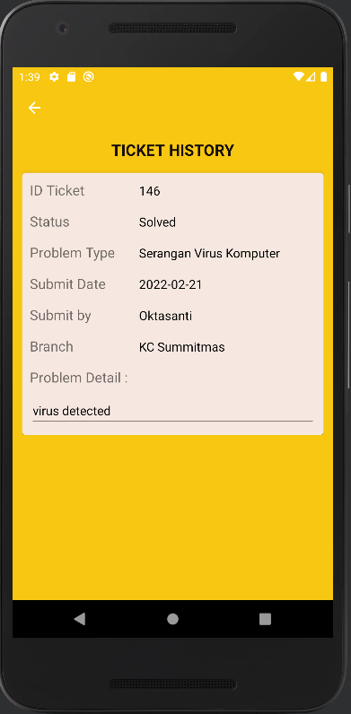
MENU HISTORY TICKET, DEVELOPER

Slide 19
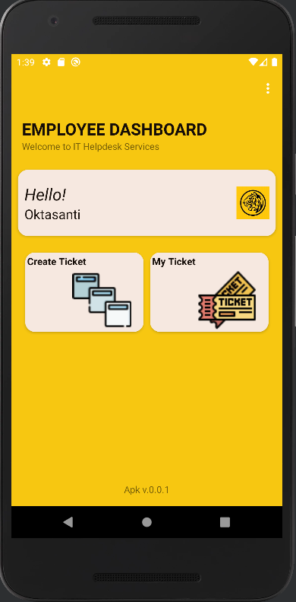
DASHBOARD EMPLOYEE

Slide 20
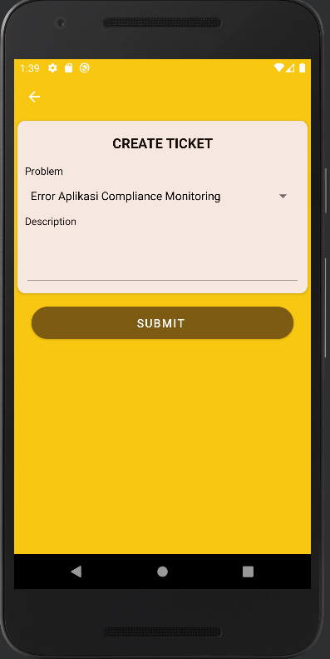
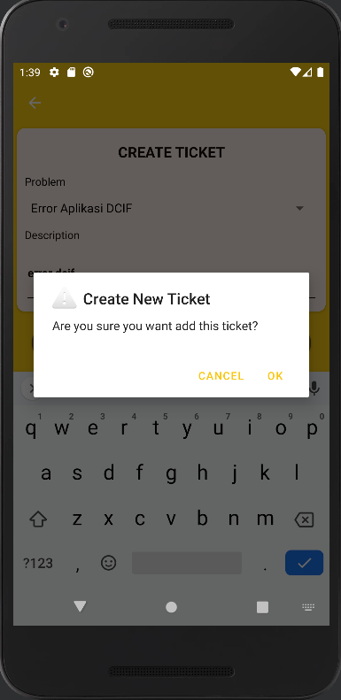
MENU CREATE TICKET EMPLOYEE

Slide 21
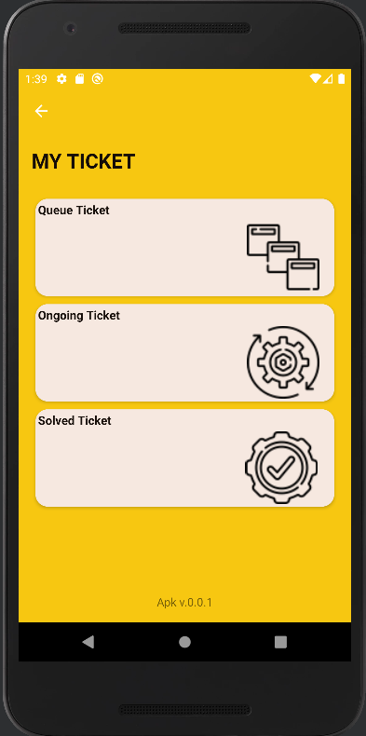
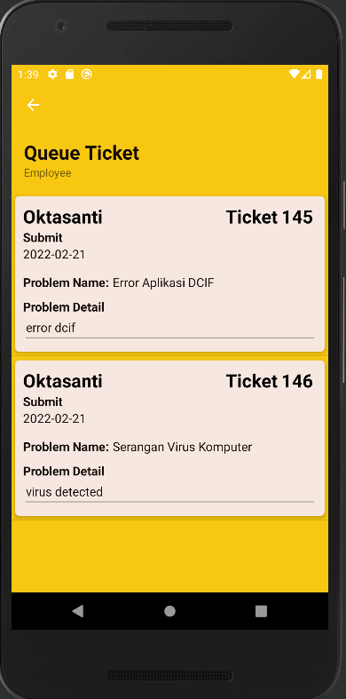
MENU MY TICKET EMPLOYEE

Slide 22
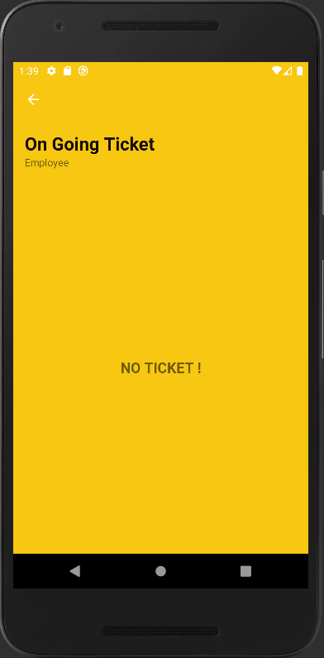
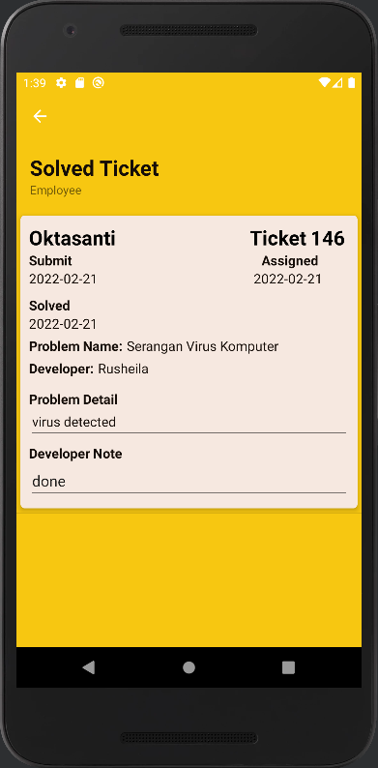
MENU ON GOING DAN SOLVED TICKET EMPLOYEE
Menu Ongoing Ticket if there is no ticket on going

Slide 23

#proudtobemaybankers

